Slide 1
PHP Classes and Objects
Chapter 10

Slide 2
Objectives
1
2
Object-Oriented Overview
Classes and Objects in PHP
3
Object Oriented Design
7

Slide 3
Object-Oriented Overview
Section 1 of 3

Slide 4
Overview
Object-Oriented Overview
PHP is a full-fledged object-oriented language with many of the syntactic constructs popularized in languages like Java and C++.
Earlier versions of PHP do not support all of these object-oriented features,
PHP versions after 5.0 do

Slide 5
Terminology
Object-Oriented Terminology
The notion of programming with objects allows the developer to think about an item with particular properties (also called attributes or data members) and methods (functions).
The structure of these objects is defined by classes, which outline the properties and methods like a blueprint.
Each variable created from a class is called an object or instance, and each object maintains its own set of variables, and behaves (largely) independently from the class once created.

Slide 6
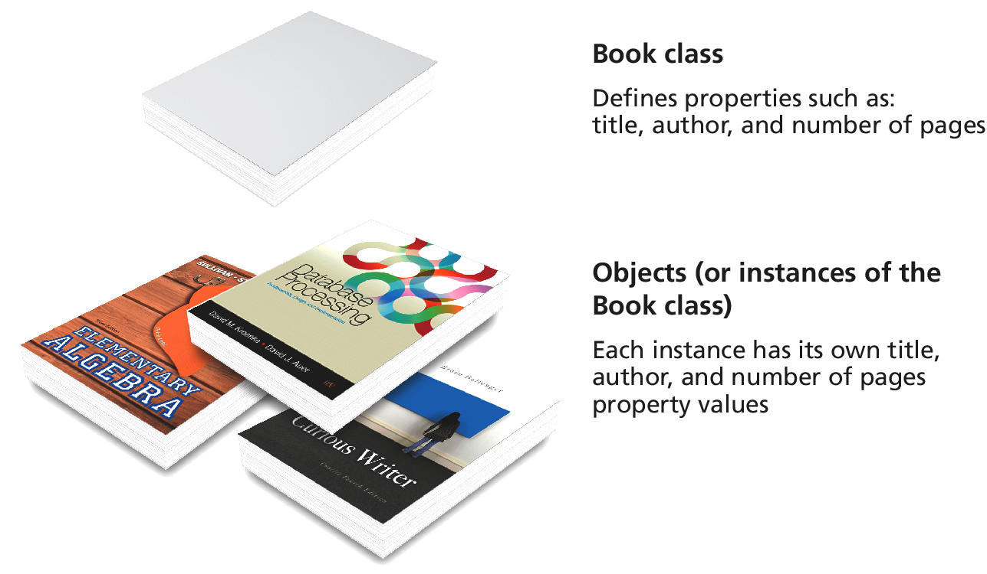
Relationship between Class and Objects

Slide 7
UML
The Unified Modelling Language
The standard diagramming notation for object-oriented design is UML (Unified Modeling Language).
Class diagrams and object diagrams, in particular, are useful to us when describing the properties, methods, and relationships between classes and objects.
For a complete definition of UML modeling syntax, look at the Object Modeling Group’s living specification

Slide 8
UML Class diagram
By example
Every Artist has a
first name,
last name,
birth date,
birth city, and
death date.
Using objects we can encapsulate those properties together into a class definition for an Artist.
UML articulates that design

Slide 9
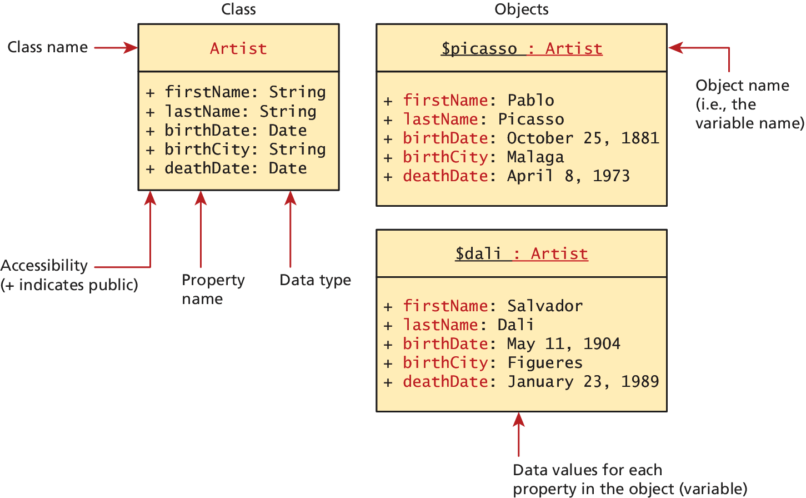
UML Class diagram
Class and a couple of objects

Slide 10
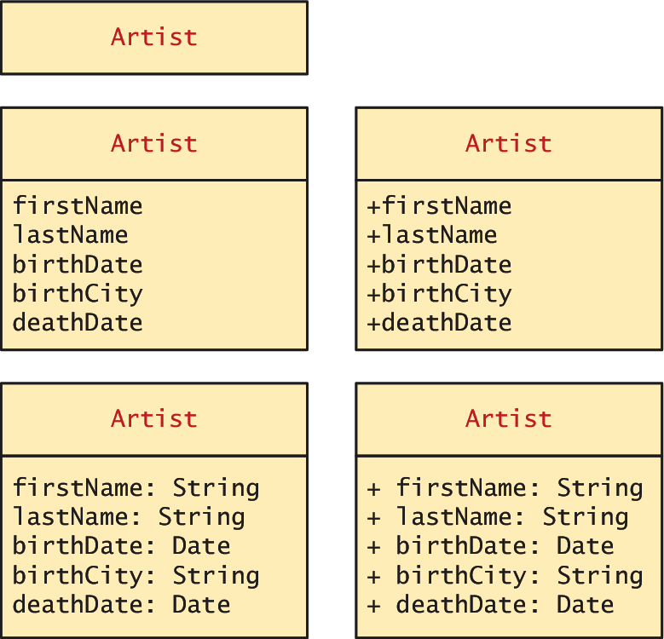
UML Class diagram
Different levels of detail

Slide 11
Server and Desktop Objects
Not the same
While desktop software can load an object into memory and make use of it for several user interactions, a PHP object is loaded into memory only for the life of that HTTP request.
We must use classes differently than in the desktop world, since the object must be recreated and loaded into memory
Unlike a desktop, there are potentially many thousands of users making requests at once, so not only are objects destroyed upon responding to each request, but memory must be shared between many simultaneous requests, each of which may load objects into memoryor each request that requires it

Slide 12
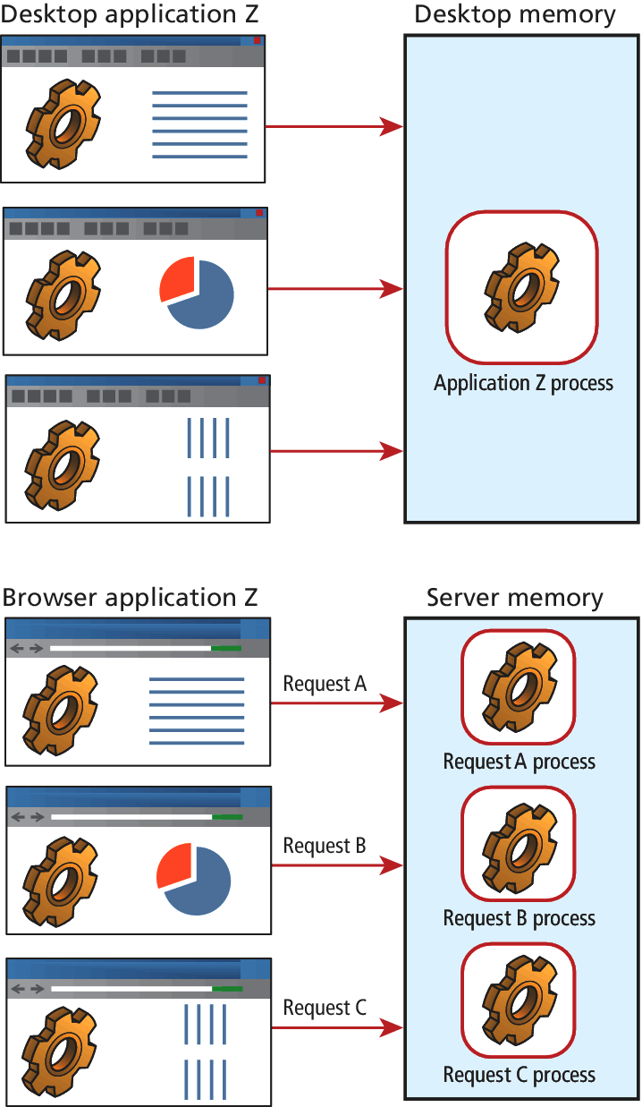
Server and Desktop Objects
Not the same

Slide 13
Objects and Classes in PHP
Section 2 of 3

Slide 14
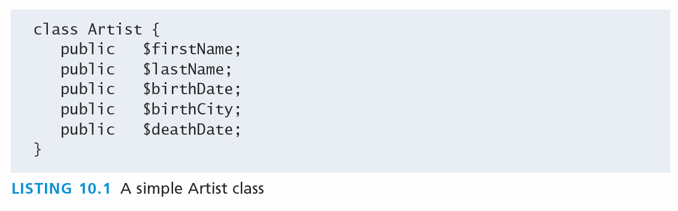
Defining Classes
In PHP
The PHP syntax for defining a class uses the class keyword followed by the class name and { } braces

Slide 15
Instantiating Objects
In PHP
Defining a class is not the same as using it. To make use of a class, one must instantiate (create) objects from its definition using the new keyword.
$picasso = new Artist();
$dali = new Artist();

Slide 16
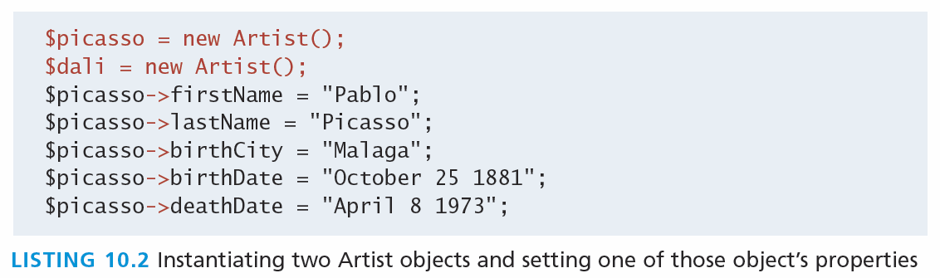
Properties
The things in the objects
Once you have instances of an object, you can access and modify the properties of each one separately using the variable name and an arrow (->).

Slide 17
Constructors
A Better way to build
Constructors let you specify parameters during instantiation to initialize the properties within a class right away.
In PHP, constructors are defined as functions (as you shall see, all methods use the function keyword) with the name __construct().
Notice that in the constructor each parameter is assigned to an internal class variable using the $this-> syntax. you must always use the $this syntax to reference all properties and methods associated with this particular instance of a class.

Slide 18
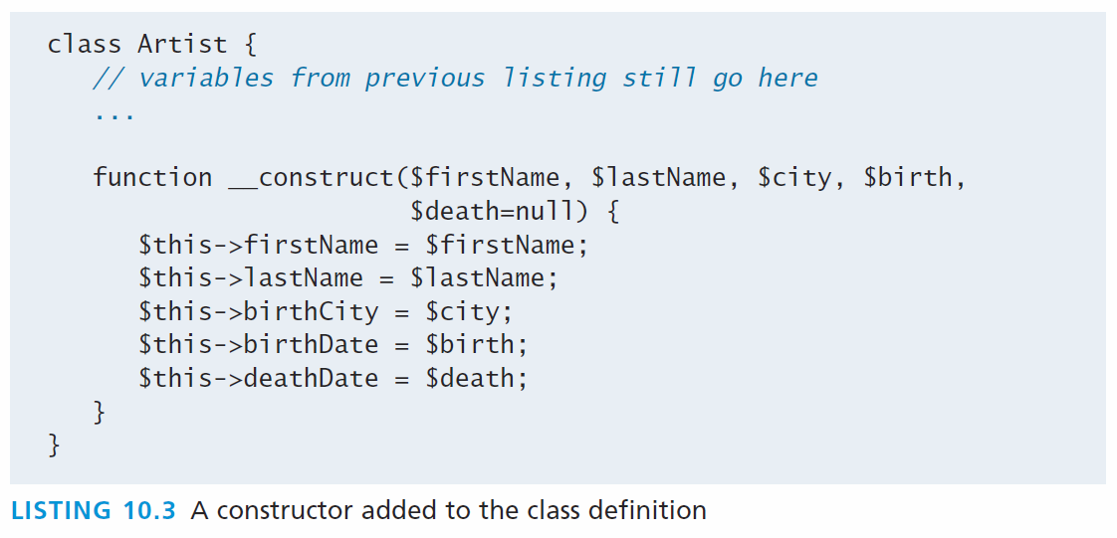
Constructors
An Example

Slide 19
Constructors
Using the constructor
$picasso = new Artist("Pablo","Picasso","Malaga","Oct 25,1881","Apr 8,1973");
$dali = new Artist("Salvador","Dali","Figures","May 11 1904", "Jan 23 1989");

Slide 20
Methods
Functions In a class
Methods and are like functions, except they are associated with a class.
They define the tasks each instance of a class can perform and are useful since they associate behavior with objects.
$picasso = new Artist( . . . )
echo $picasso->outputAsTable();

Slide 21
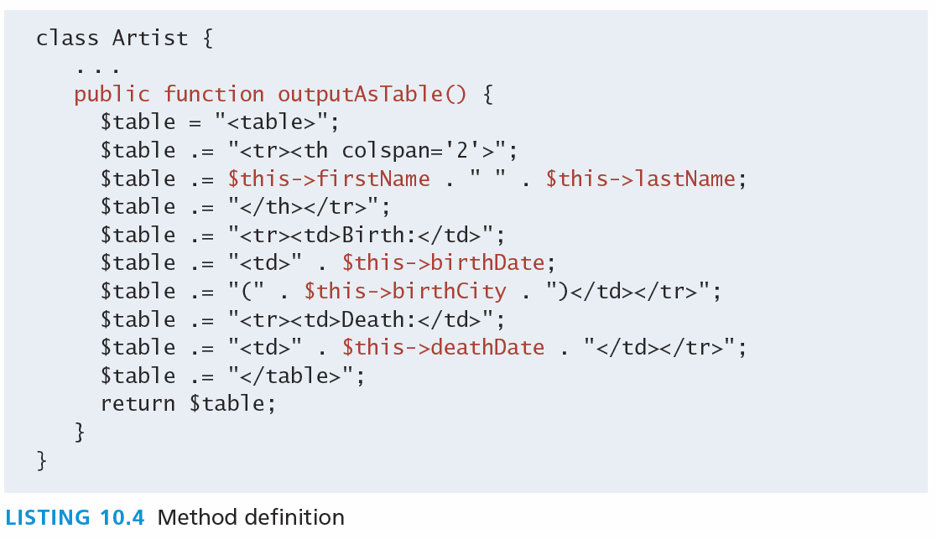
Methods
The example definition

Slide 22
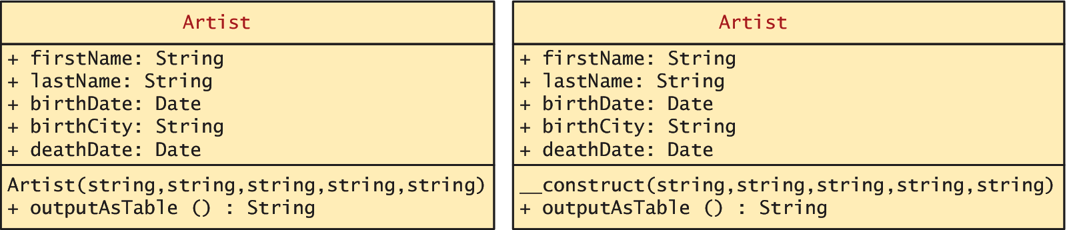
Methods
UML class diagrams adding the method

Slide 23
Visibility
Or accessibility
The visibility of a property or method determines the accessibility of a class member and can be set to:
Public the property or method is accessible to any code that has a reference to the object
Private sets a method or variable to only be accessible from within the class
Protected is related to inheritance…

Slide 24
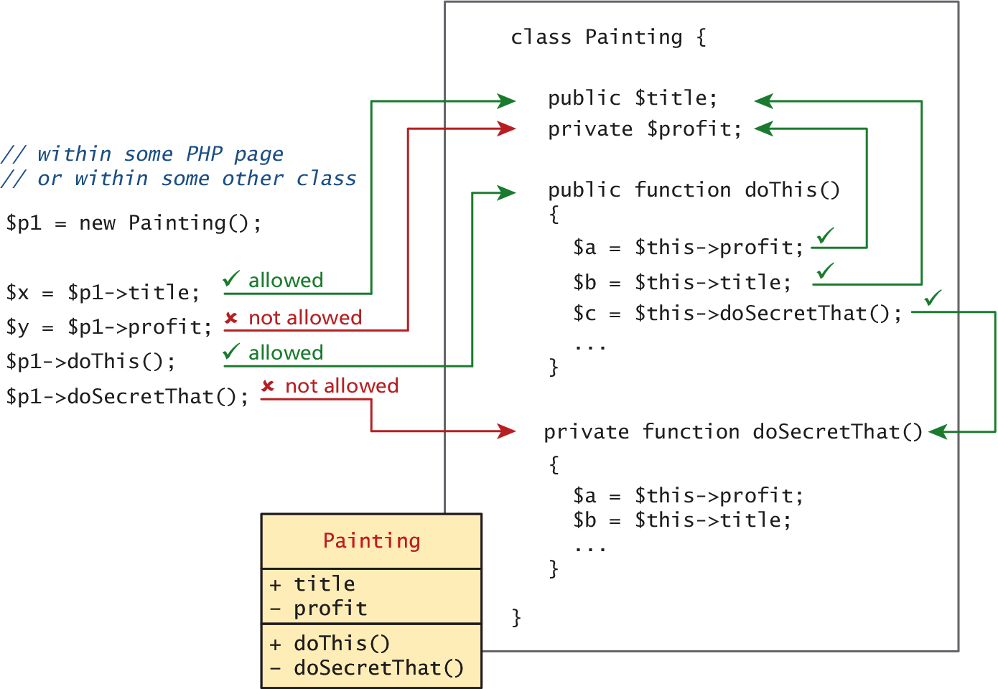
Visibility
Or accessibility

Slide 25
Static Members
A static member is a property or method that all instances of a class share.
Unlike an instance property, where each object gets its own value for that property, there is only one value for a class’s static property.
Static members use the self:: syntax and are not associated with one object
They can be accessed without any instance of an Artist object by using the class name, that is, via Artist::$artistCount.

Slide 26
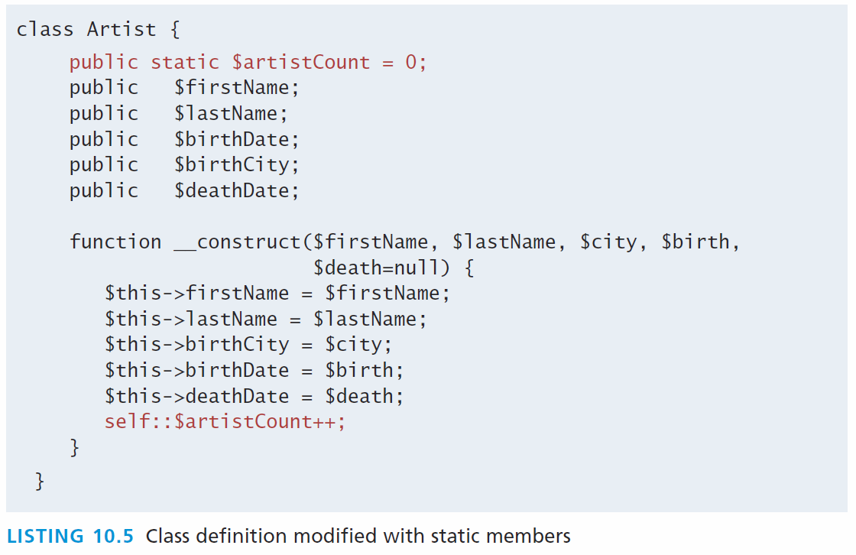
Static Members

Slide 27
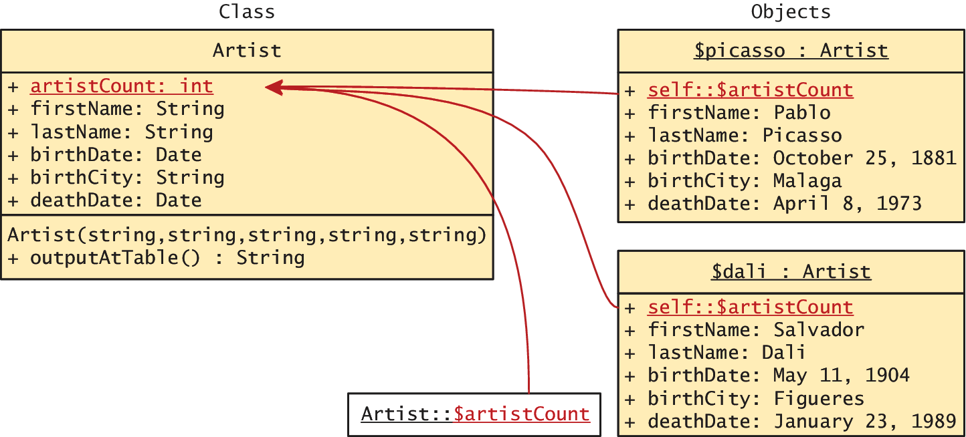
Static Members
Uml again

Slide 28
Class constants
Never changes
Constant values can be stored more efficiently as class constants so long as they are not calculated or updated
They are added to a class using the const keyword.
const EARLIEST_DATE = 'January 1, 1200';
Unlike all other variables, constants don’t use the $ symbol when declaring or using them.
Accessed both inside and outside the class using
self::EARLIEST_DATE in the class and
classReference::EARLIEST_DATE outside.

Slide 29
Object Oriented Design
Section 2 of 3

Slide 30
Data Encapsulation
What is it?
Perhaps the most important advantage to object-oriented design is the possibility of encapsulation, which generally refers to restricting access to an object’s internal components.
Another way of understanding encapsulation is: it is the hiding of an object’s implementation details
A properly encapsulated class will define an interface to the world in the form of its public methods, and leave its data, that is, its properties, hidden (that is, private).

Slide 31
Data Encapsulation
Getters and setters
If a properly encapsulated class makes its properties private, then how do you access them?
getters
setters

Slide 32
Data Encapsulation
Getters
A getter to return a variable’s value is often very straightforward and should not modify the property.
public function getFirstName() {
return $this->firstName;
}

Slide 33
Data Encapsulation
Setters
Setter methods modify properties, and allow extra logic to be added to prevent properties from being set to strange values.
public function setBirthDate($birthdate){ // set variable only if passed a valid date string $date = date_create($birthdate); if ( ! $date ) { $this->birthDate = $this->getEarliestAllowedDate(); } else { // if very early date then change it to // the earliest allowed date if ( $date < $this->getEarliestAllowedDate() ) { $date = $this->getEarliestAllowedDate(); } $this->birthDate = $date; }
}

Slide 34
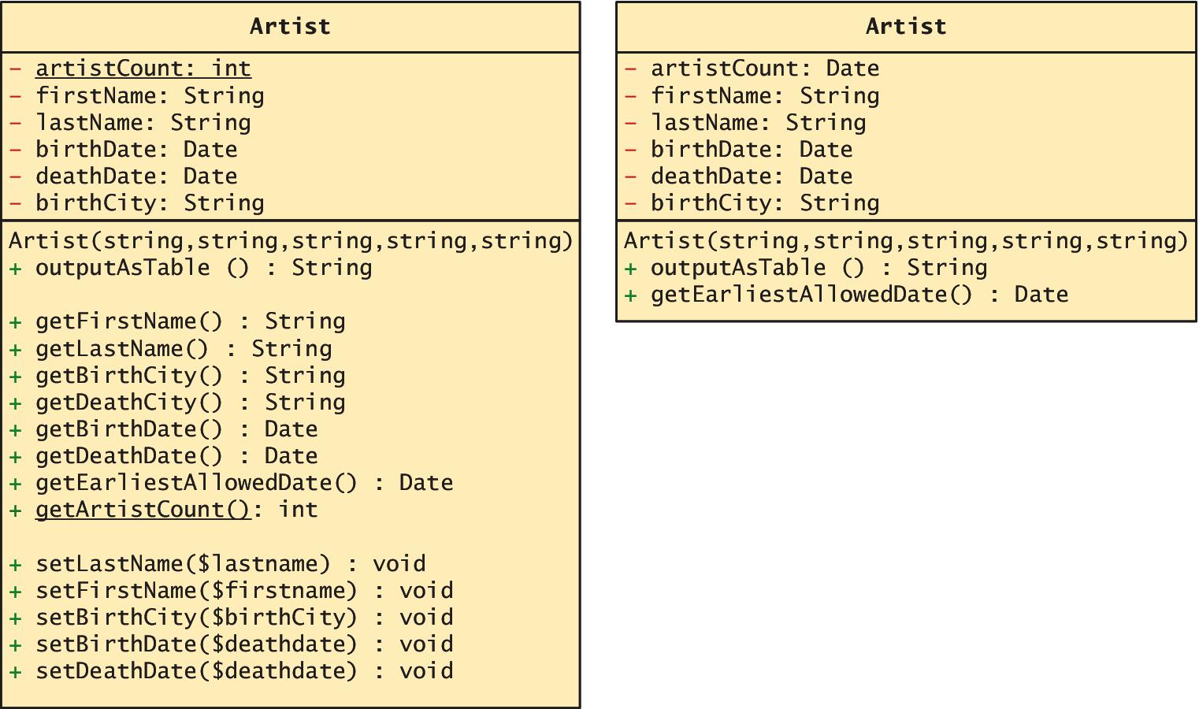
Data Encapsulation
UML

Slide 35
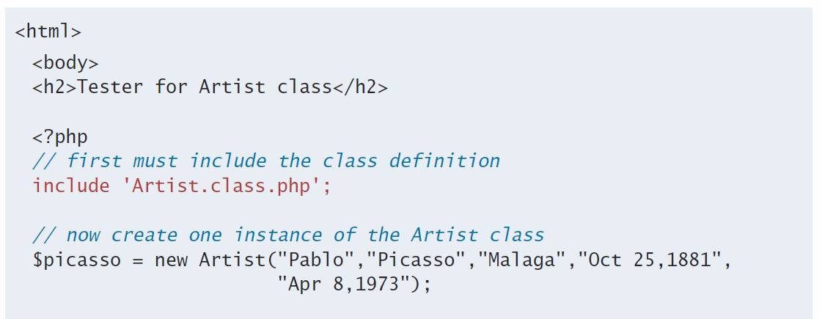
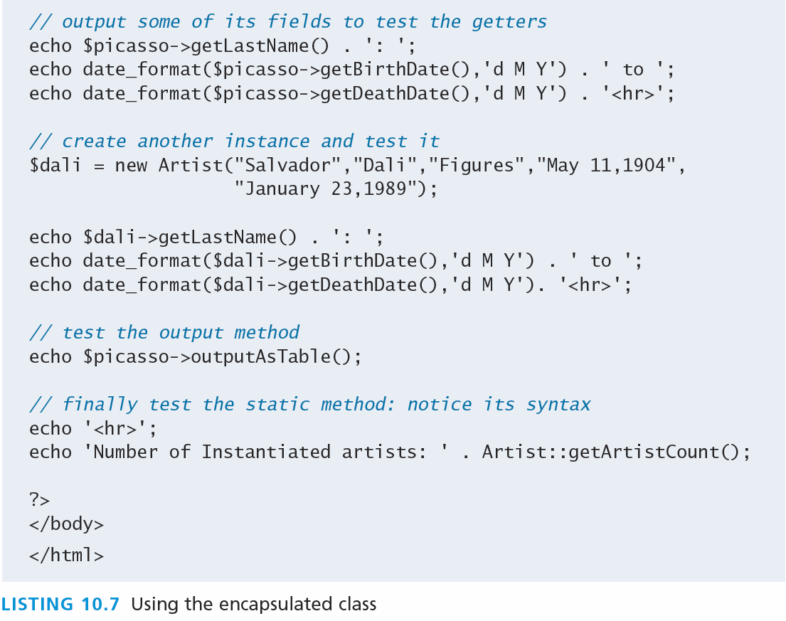
Data Encapsulation
Using an encapsulated class

Slide 36
Inheritance
Inheritance enables you to create new PHP classes that reuse, extend, and modify the behavior that is defined in another PHP class.
PHP only allows you to inherit from one class at a time
A class that is inheriting from another class is said to be a subclass or a derived class
The class that is being inherited from is typically called a superclass or a base class
A PHP class is defined as a subclass by using the extends keyword.
class Painting extends Art { . . . }

Slide 37
Referencing the Base Class
Inheritance enables you to create new PHP classes that reuse, extend, and modify the behavior that is defined in another PHP class.
PHP only allows you to inherit from one class at a time
A class that is inheriting from another class is said to be a subclass or a derived class
The class that is being inherited from is typically called a superclass or a base class
A PHP class is defined as a subclass by using the extends keyword.
class Painting extends Art { . . . }

Slide 38
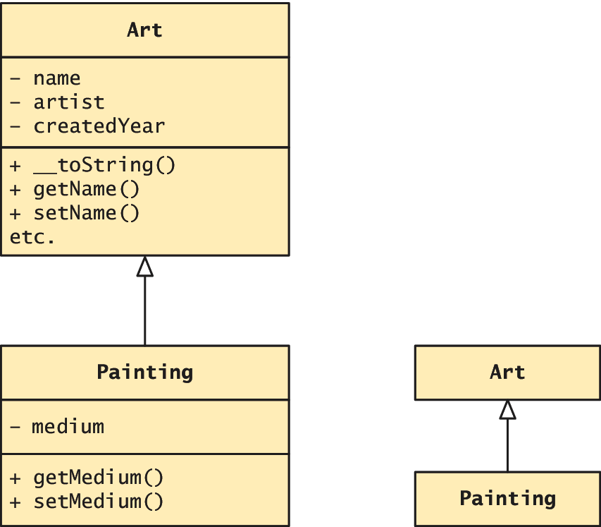
Inheritance
There’s UML for that too

Slide 39
Example usage
$p = new Painting();
. . .
echo $p->getName(); // defined in base class
echo $p->getMedium(); // defined in subclass

Slide 40
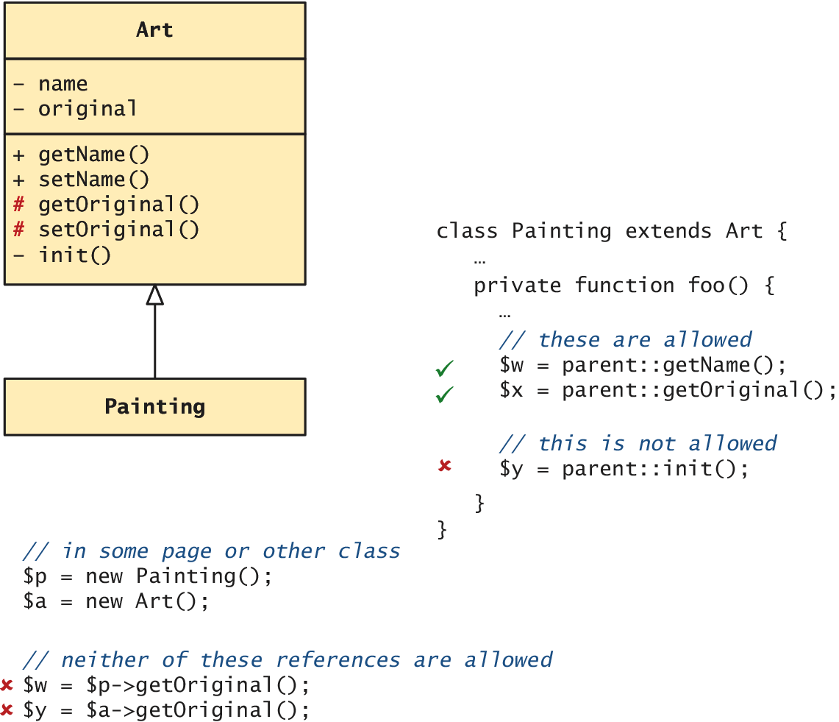
Protected access modifier
Remember Protected?

Slide 41
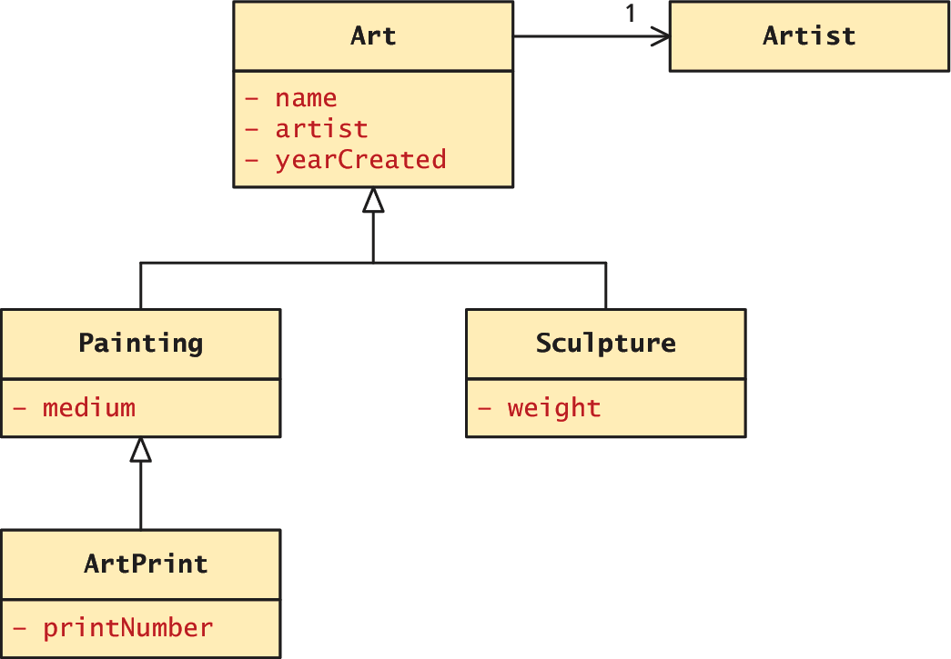
A More Complex Example
Using inheritance

Slide 42
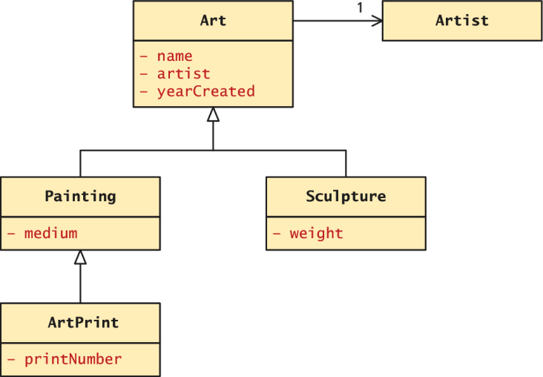
Extended example
All art has certain properties
/* The abstract class that contains functionality required by all types of Art */
abstract class Art {
private $name;
private $artist;
private $yearCreated;
//… constructor, getters, setters

Slide 43
Extended example
Painting require a “medium”
class Painting extends Art {
private $medium;
//…constructor, getters, setters
public function __toString() {
return parent::__toString() . ", Medium: " . $this->getMedium();
}
}

Slide 44
Extended example
Sculptures have weight
class Sculpture extends Art {
private $weight;
//…constructor, getters, setters
public function __toString() {
return parent::__toString() . ", Weight: " .
$this->getWeight() ."kg";
} }

Slide 45
Extended example
Using the classes
…
$picasso = new Artist("Pablo","Picasso","Malaga","May 11,904”,"Apr 8, 1973");
$guernica = new Painting("1937",$picasso,"Guernica”, "Oil on canvas");
$woman = new Sculpture("1909",$picasso,"Head of a Woman", 30.5);
?>
<h2>Paintings</h2>
<p><em>Use the __toString() methods </em></p>
<p><?php echo $guernica; ?></p>
<h2>Sculptures</h2>
<p> <?php echo $woman; ?></p>

Slide 46
Polymorphism
No thank you, I’ll have water
Polymorphism is the notion that an object can in fact be multiple things at the same time.
Consider an instance of a Painting object named $guernica created as follows:
$guernica = new Painting("1937",$picasso,"Guernica","Oil on canvas");
The variable $guernica is both a Painting object and an Art object due to its inheritance.
The advantage of polymorphism is that we can manage a list of Art objects, and call the same overridden method on each.

Slide 47
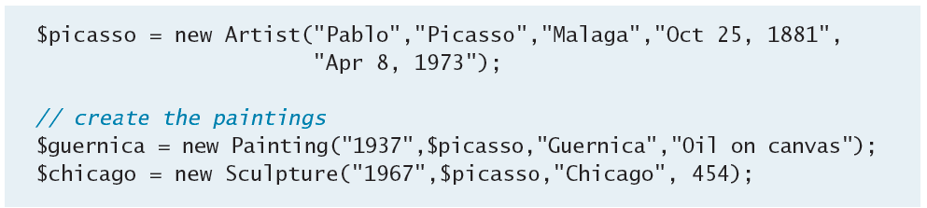
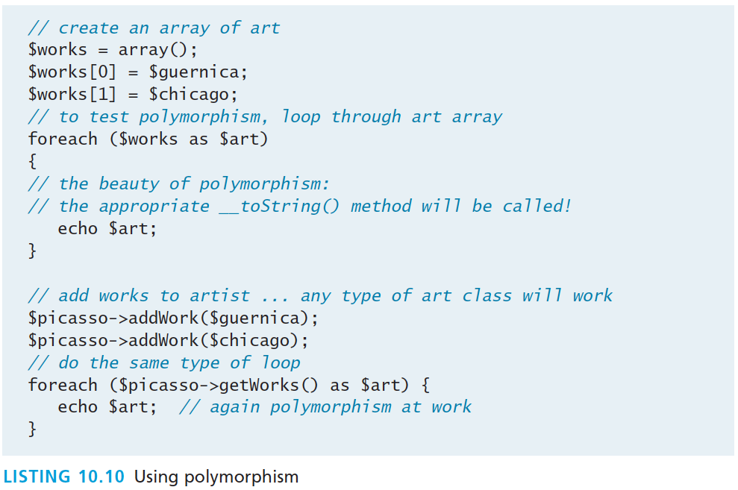
Polymorphism

Slide 48
Interfaces
Defining the interface
An object interface is a way of defining a formal list of methods that a class must implement without specifying their implementation.
Interfaces are defined using the interface keyword, and look similar to standard PHP classes, except an interface contains no properties and its methods do not have method bodies defined.
interface Viewable {
public function getSize();
public function getPNG();
}

Slide 49
Interfaces
Defining the interface
An object interface is a way of defining a formal list of methods that a class must implement without specifying their implementation.
Interfaces are defined using the interface keyword, and look similar to standard PHP classes, except an interface contains no properties and its methods do not have method bodies defined.
interface Viewable {
public function getSize();
public function getPNG();
}

Slide 50
Interfaces
Imnplmeneting the Interface
In PHP, a class can be said to implement an interface, using the implements keyword:
class Painting extends Art implements Viewable { ... }
This means then that the class Painting must provide implementations for the getSize() and getPNG() methods.

Slide 51
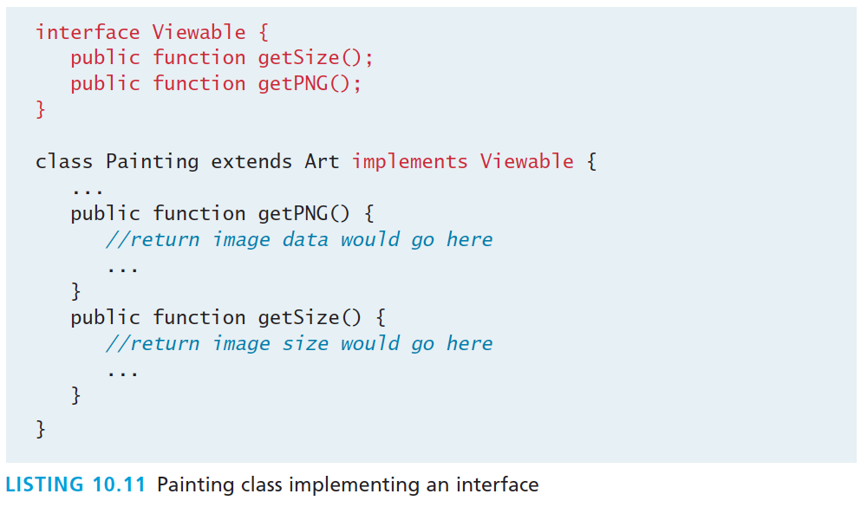
Interface Example

Slide 52
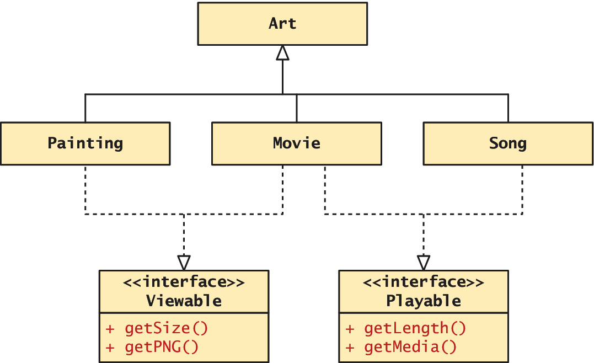
Interfaces
An Extended example

Slide 53
What You’ve Learned
1
2
Object-Oriented Overview
Classes and Objects in PHP
3
Object Oriented Design
7

